Slide 1
Intel mkl-dnn library for low-precision cnn inference

Slide 2
The problem
We need to improve the performances of using deep neural networks:
Time requirements:
loading time
Inference time
Memory requirements:
Parameters storage
Inference buffers

Slide 3
The idea
Use hardware vector operations on CPU and quantize network parameters.
Expected results:
reduced memory bandwidth should avoid this bottleneck
reduced buffer size should increase cache efficiency
synergy between shrinking of parameters and vector operations: able to parallelize more operations on the same vector registers

Slide 4
The tool
We need a CPU with extensions for SIMD instructions: we will use different Intel processors with SSE and AVX ISA extensions
We need a framework optimized to use these extensions on deep neural networks supporting also low precision inference: we will use Intel MKL-DNN

Slide 5
What is mkl-dnn?
Intel framework to provide hardware optimized building blocks for deep neural networks:
Operation/memory descriptor - description with logical parameters of an operation or memory.
Primitive descriptor - complete description of a primitive that contains an operation descriptor, descriptors of primitive inputs and outputs, and the target engine
Primitive - the real allocation of necessary resources according to a primitive descriptor. This may be either a basic algorithm (e.g. convolution) or a memory buffer.

Slide 6
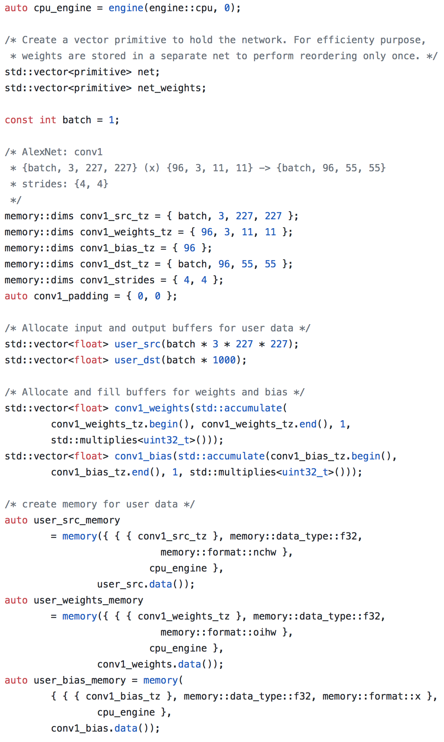
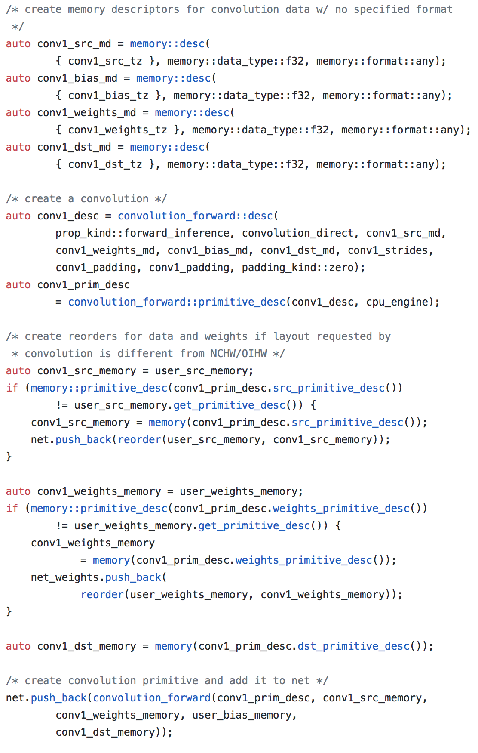
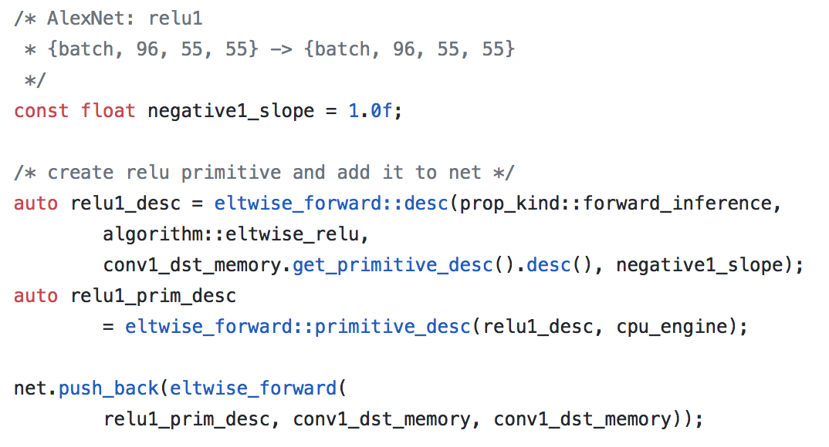
How does a convolution layer look like in mkl-dnn
https://github.com/intel/mkl-dnn/blob/master/examples/simple_net.cpp

Slide 7
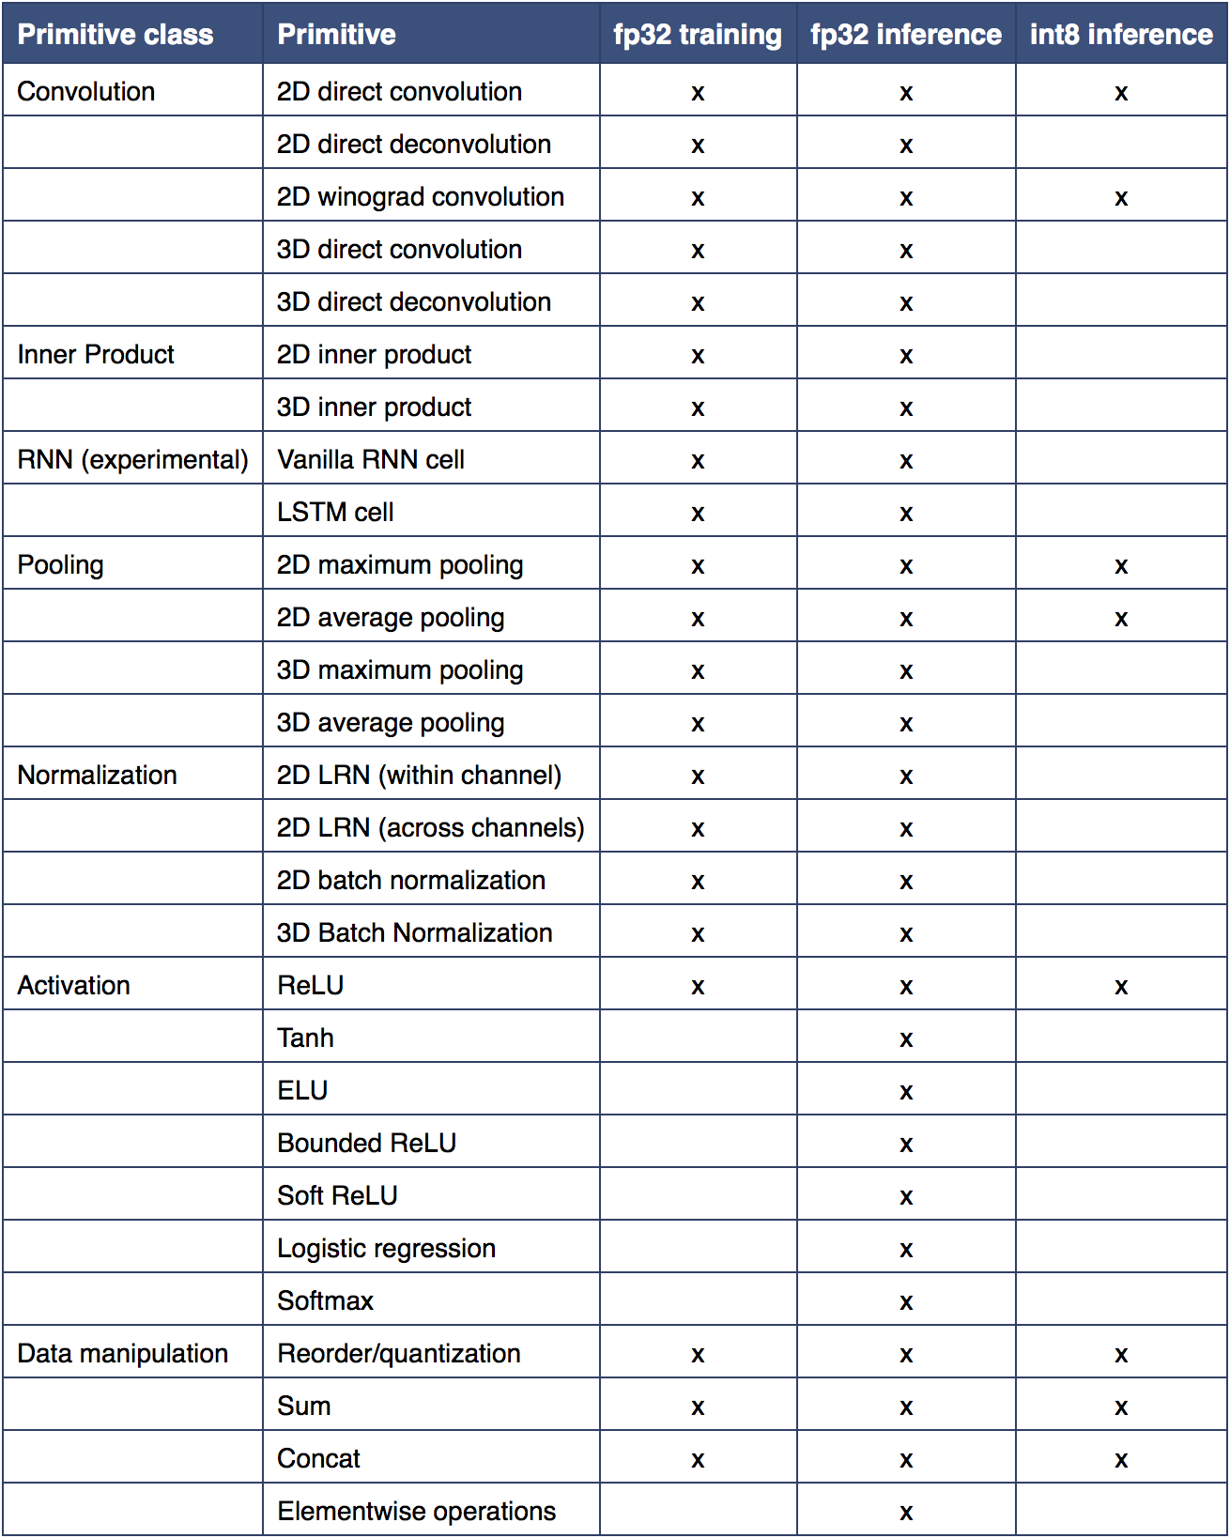
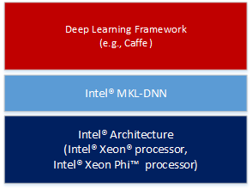
MKL-DNN current state
https://software.intel.com/en-us/articles/intel-mkl-dnn-part-1-library-overview-and-installation https://intel.github.io/mkl-dnn/

Slide 8

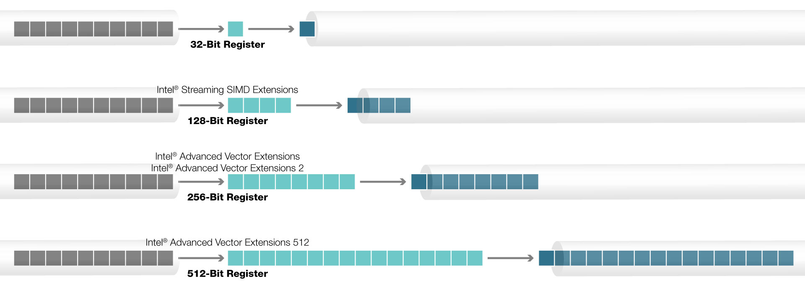
Used vector extensions
http://www.prowesscorp.com/what-is-intel-avx-512-and-why-does-it-matter/ https://github.com/intel/mkl-dnn/tree/master/src/cpu

Slide 9
Our tests
We want to address the relative advantages of quantized inference with MKL-DNN
base dummy network: fully convolutional (30×3×230×230 input, 30×64×230×230 channels each convolution), varying depth
Address the overall quality: compare setup times, inference times, and memory usage for different depth of the dummy network
Identify inference bottlenecks in a realistic use case: compare inference times per layer of a classical VGG16 network architecture
Spot optimization triggers: compare inference times varying load and either the batch size or the channel number on the dummy network

Slide 10
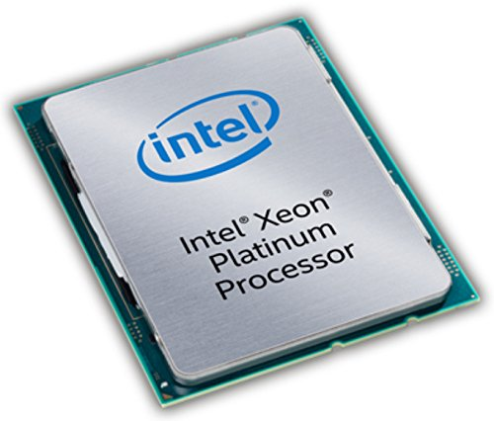
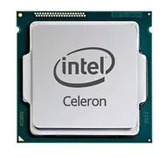
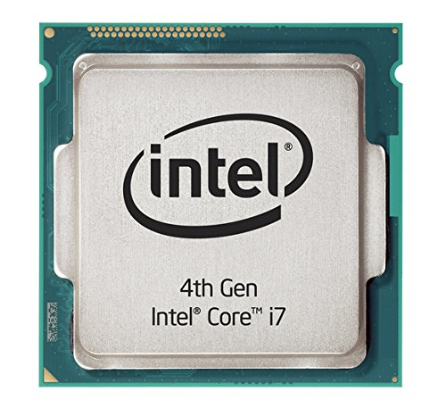

Our hardware
Intel Celeron CPU 877
Intel(R) Core(TM) i7-4820K
Intel Xeon Platinum 8168
SSE4.2
AVX2
AVX512

Slide 11
Our benchmarks
Intel(R) Celeron(R) CPU 877 @ 1.40GHz (2 Threads)

Slide 12
Our benchmarks
Intel(R) Core(TM) i7-4820K CPU @ 3.70GHz (8 Threads)

Slide 13
Our benchmarks
Intel(R) Xeon(R) Platinum 8168 CPU @ 2.70GHz (8 Threads)

Slide 14
Our benchmarks
Intel(R) Xeon(R) Platinum 8168 CPU @ 2.70GHz (8 Threads)

Slide 15
Our benchmarks
Intel(R) Xeon(R) Platinum 8168 CPU @ 2.70GHz (8 Threads)

Slide 16
Our benchmarks
Intel(R) Xeon(R) Platinum 8168 CPU @ 2.70GHz (8 Threads)

Slide 17
Our benchmarks
Intel(R) Xeon(R) Platinum 8168 CPU @ 2.70GHz (8 Threads)

Slide 18
Our benchmarks
Intel(R) Xeon(R) Platinum 8168 CPU @ 2.70GHz (8 Threads)

